Slide 1
Build your vpc and launch a web server

Slide 2
Next choose create vpc
Step1:Firstly,we have to login to your AWS accounts with username and passward.
Step 2: Go to modules and move for module 5 lab-2
Step3:choose start lab.until u see lab status is ready.choose X to close panel.
Step 4:choose AWS
Step 5:in searchbox type vpc to open vpc console
Step 6:Choose the vpc dashboard link

Slide 3
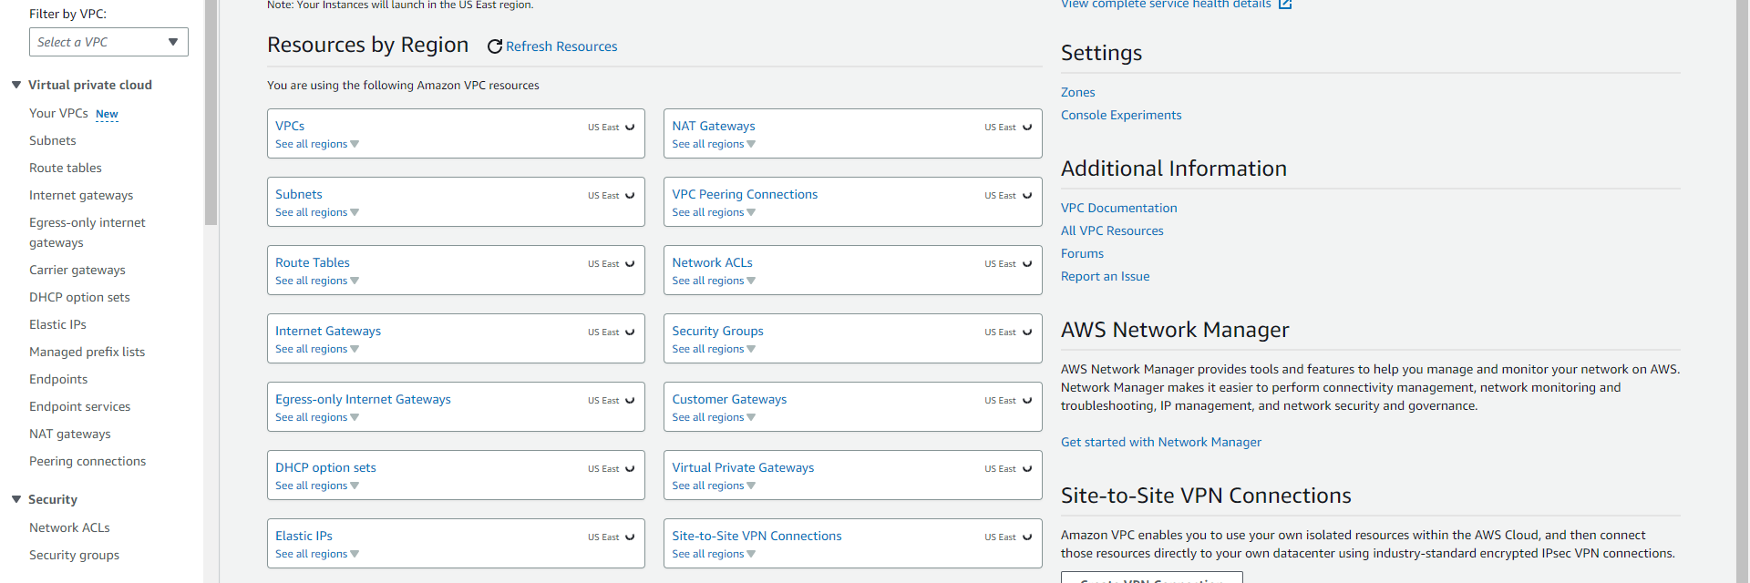
configure VPC details in vpc setting panel on left
STEP 7: Choose VPC and more.
STEP 8:Under nametag autogeneration change the value from project to lab.
STEP 9:Keep ipv4 CIDR BLOCK as 10.0.0.0/16
STEP 10:keep no of availability zone 1.
STEP 11:Keep no of public subnets 1.
STEP 12:Keep no of private subnets 1.

Slide 4
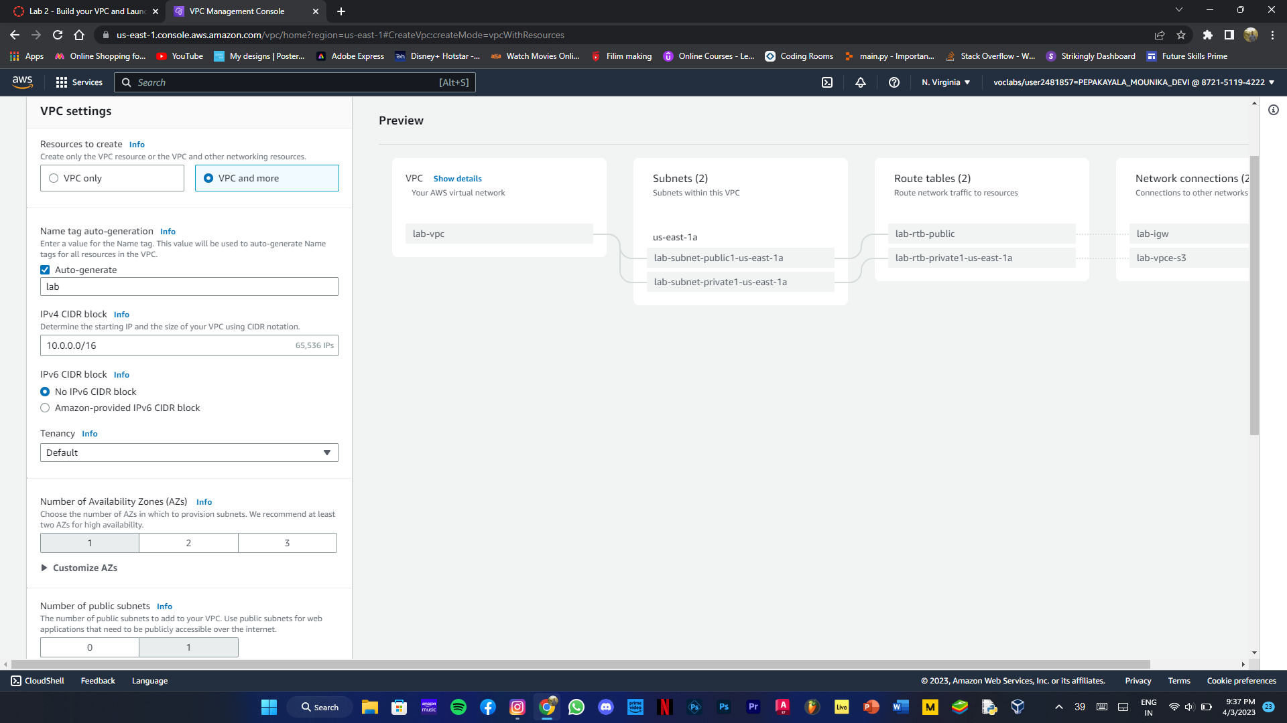

Slide 5
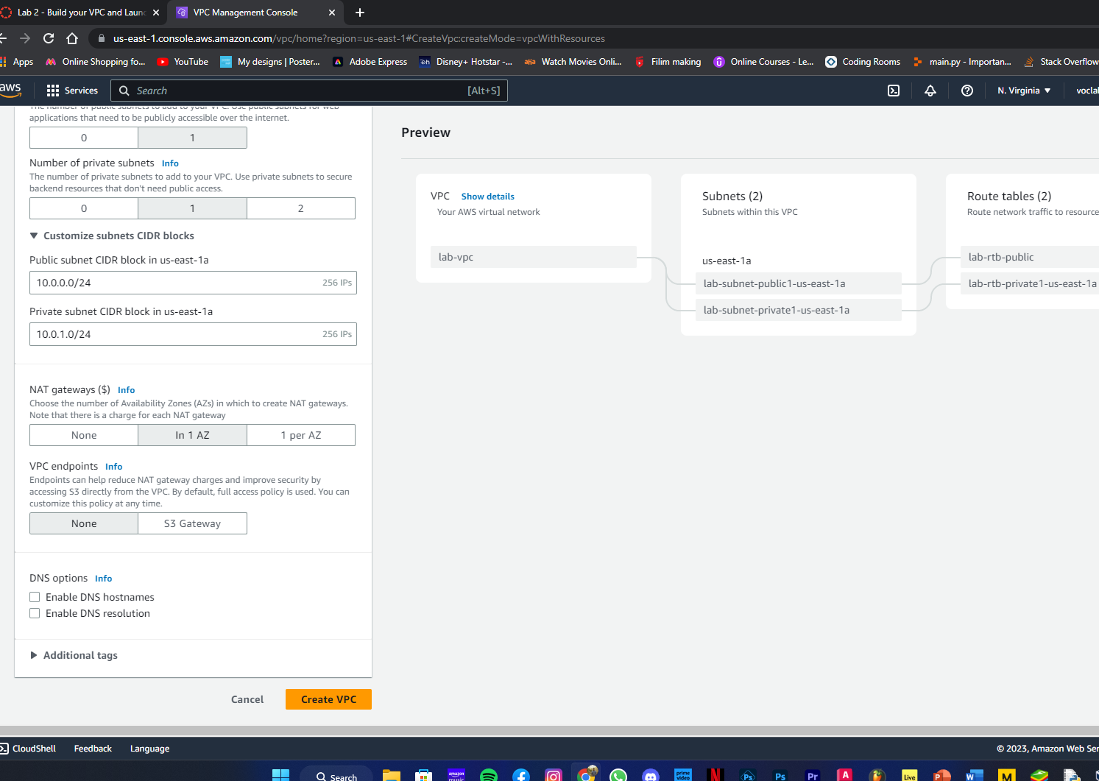
EXpaND THE CUSTOMIZED SUBNETS CIDR BLOCKS SECTION
STEP 13:Public subnet CIDR block in us-east-1a to 10.0.0.0/24.
STEP 14:Private subnet CIDR block in us-east-1a to 10.0.1.0/24.
Step 15:set NAT gateways in 1 in AZ.
STEP 16:VPC Endpoints to NONE
STEP 17Keep both DNS hostnames and resolution enabled
STEP 18 :CREATE VPC

Slide 6
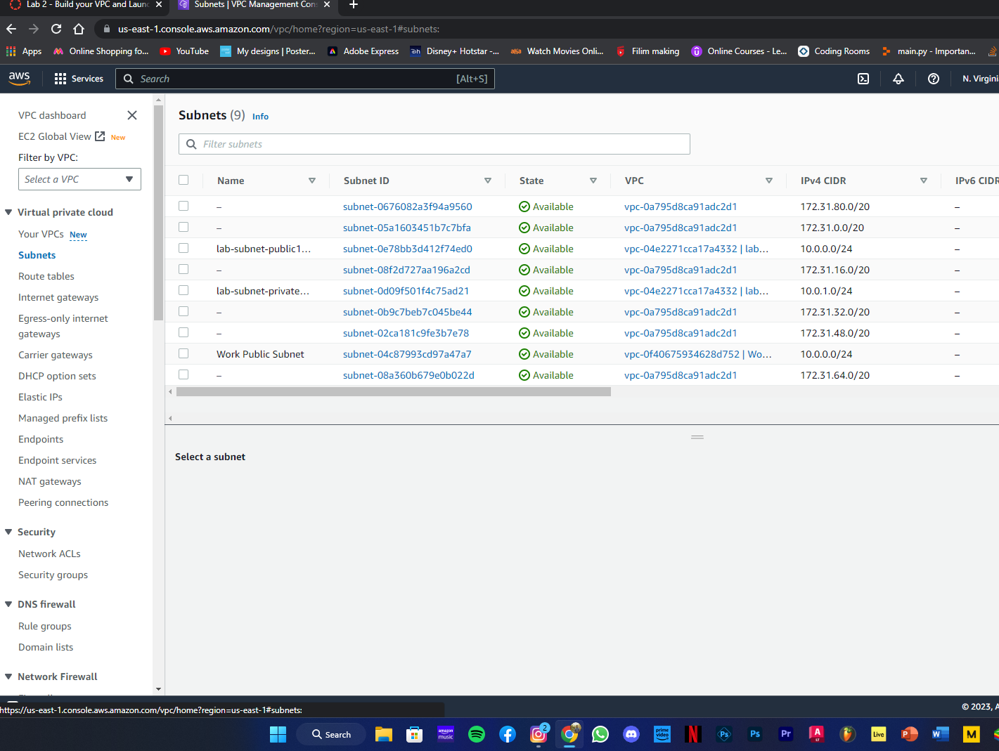

Slide 7
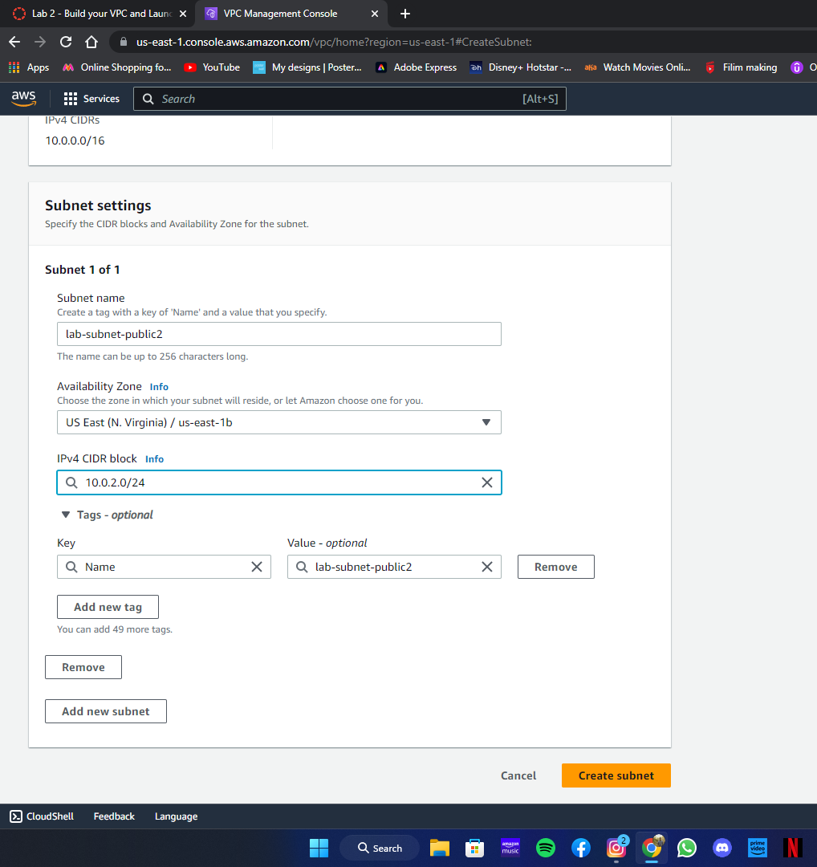
CREATE ADDITIONAL SUBNET
STEP 19:In the navigation pane choose subnets.
STEP 20:Choose create subnet.
STEP 21:VPC ID:lab-vpc(from menu)
subnet name:lab-subnet-public2
availability zone:select 2nd zone
IPV4 CIDR block :10.0.2.0/24
STEP 22:Create subnet

Slide 8
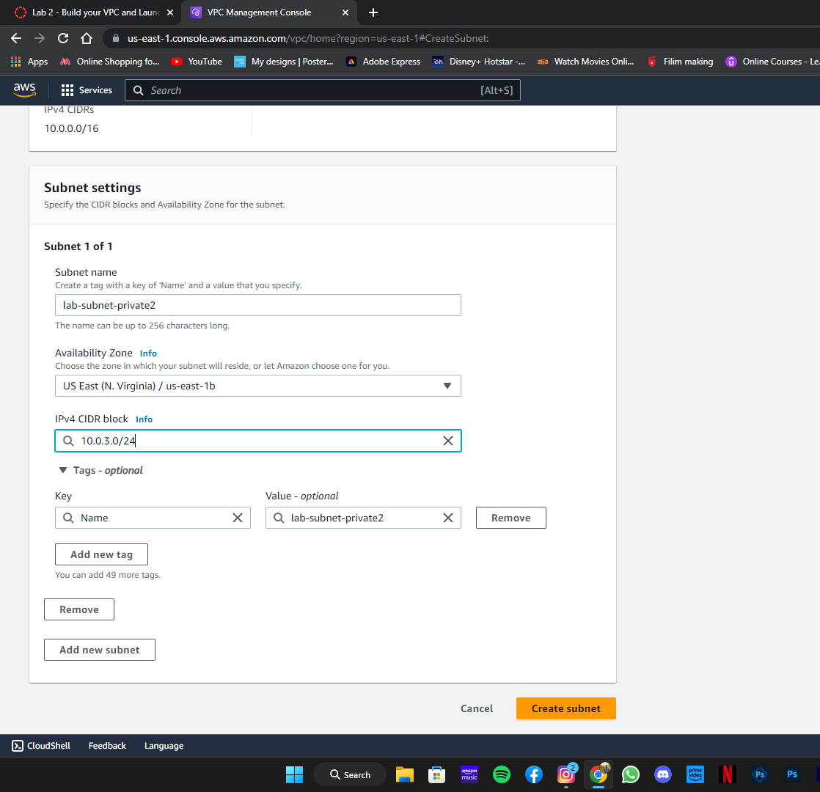
CREATING 2ND SUBNET:
STEP 23:choose create subnet
VPC id:lab-vpc
Subnet name:lab-subnet-private-2
Availability zone:select 2nd zone
IPV4 CIDR block:10.0.3.0/24
STEP 24:Choose create subnet.

Slide 9
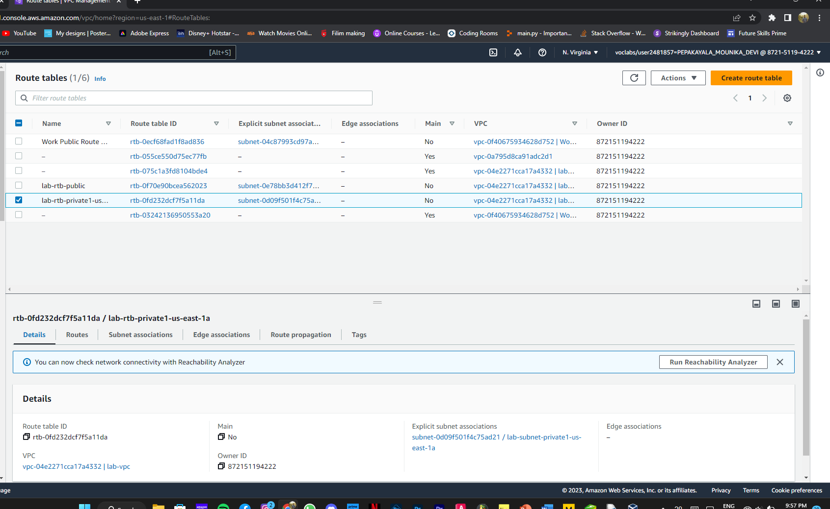
In left navigation pane choose route tables
STEP 25:Select the lab-rtb-private1-us-east-1a route table.
STEP 26:in the lower pane choose routes tab
STEP 27:Choose the Subnet association tab.
STEP 28:CLICK edit subnet association
STEP 29: leave lab-subnet-private1-us-east-1a
And select lab-subnet-private2
STEP 30:Choose save associations
STEP 31:Select lab-rtb-public route talickble.
Choose route tabs
Choose subnet associations
Click edit subnet assaciations

Slide 10
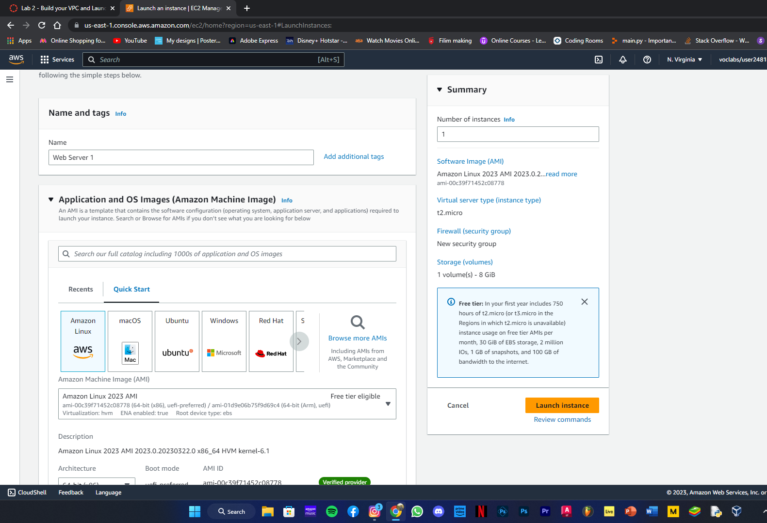
Leave lab-subnet-public1-east-1a.select lab subnet public 2
STEP 32:Save association
Step 33:NOW CREATE A VPC SECURITY GROUP.
Step 34:Choose security group from left pane.
Step 35: Choose Create secutity group.
Security group name:Web Security Group
Descripition:Enable http access
VPC:choose lab vpc
In inbound rules pane choose add rule
Step 36:TYPE:HTTP
Source:anywhere IPV4
Description:permit web requests
Choose create security group.

Slide 11
Launch a web server instance
STEP 37:in search box to right of services,searh for &choose EC2 open console.
Choose launch instance
Name of the instance:web server 1
Choose AMI and keep amazon linux
Choose instance type And put as t2.micro
Select key pair name as vockey.
Step 38:configure network settings
Choose edit
NETWORK:lab-vpc
Subnet:lab-subnet-public2

Slide 12
Select existing security group
STEP 39:FOR common security group select web security groupgure
In configure storage section,keep default settings.
Step 40:expand advanced details panel
Under user databox copy and paste the code.

